Slide 1
Simple past with the verb be
Basic 07 – Unit 8

Slide 2
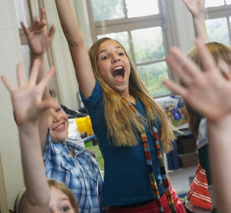
USING BE in the PAST TIME
I am in class today.
was
I in class yesterday.
8-1 USING BE: PAST TIME

Slide 3
PRESENT TIME
PAST TIME
(a) I am in class today.
(b) I was in class yesterday.
(c) Abu is here today.
(d) Abu was here yesterday.
(e) We are happy today.
(f) We were happy yesterday.

Slide 4
Singular
Plural
I was
we were
you were
you were
she was
he was
it was
they were

Slide 5
SIMPLE PAST TENSE OF BE
I
she
he
it
we
you
they
+ were
+ was

Slide 6

be
present
past
at work
was
yesterday.
I ___
am
today.

Slide 7
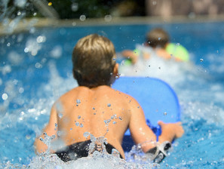
present
be
past
is
last week.
He ___
today.
was
in the pool

Slide 8
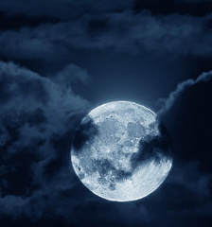
present
be
past
The moon ____ huge
tonight.
was
is
last night.

Slide 9
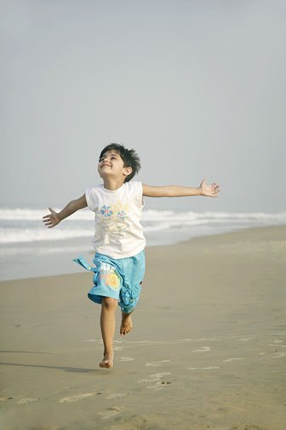
present
The water is nice today.
past
__________________

Slide 10

I was not in class yesterday.

Slide 11
(a) I was not in class yesterday.
(b) She wasn’t in class yesterday.
was + not = wasn’t
I
she
he
it
+ wasn’t

Slide 12
(c) You were not home last night.
(d) You weren’t home last night.
were + not = weren’t
we
you
they
+ weren’t

Slide 13

Jack is in class this morning, but
________ in class yesterday morning.
he wasn’t

Slide 14
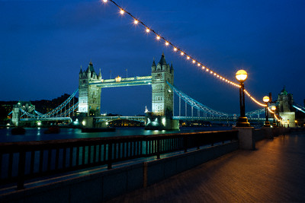
They are in London tonight, but
___________ in London last night.
they weren’t

Slide 15
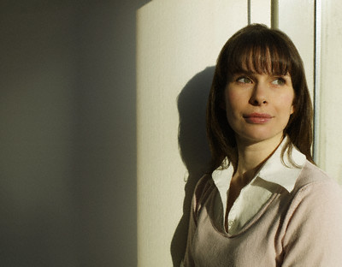
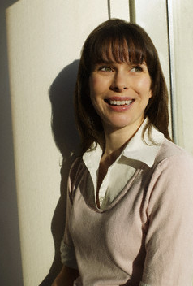
She is happy today, but
She wasn’t happy
________________ yesterday.

Slide 16

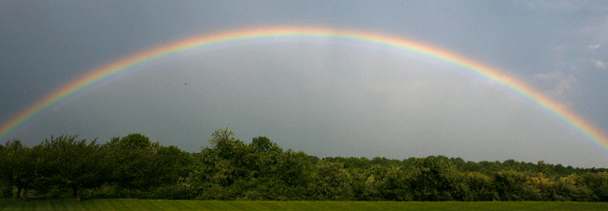
The weather is nice this week, but
___________ last week.
it wasn’t nice

Slide 17
Simple Past
Any event, activity, or state that started and finished in the past
Key words:
yesterday …
In 2006/2008
last week/month/year/time
two hours/days/months/years ago

Slide 18
Were you in class yesterday?
Yes, I was.
No, I wasn´t.

Slide 19
Questions in the simple past
Was/Were + Subject + compliment ?
Was he from Italy?
Yes, + subject + was / were.
Yes, he was.
No, subject + was / were not (wasn’t / weren’t) + …
No, he wasn’t

Slide 20
Questions in the simple past
Wh- + was/+ Subject + complement ?
were
Where was he from?
He was from Italy.

Slide 21
Questions in the simple past
Wh- + was/were + Subject + compliment ?
Where was he from?
He was from Italy.
Was/Were + Subject + compliment ?
Was he from Italy?
Yes, + subject + was / were.
Yes, he was.
No, subject + was / were not (wasn’t / weren’t) + …
No, he wasn’t

Slide 22
PRESENT TIME
PAST TIME
Are you in school now?
Were you in school?
Is he from Lima?
Was he from Lima?
Is there a bathroom in
your bedroom?
Was there a bathroom in
Your bedroom?
Are they singers?
Were they singers?
Are you married?
Were you married?

Slide 23
PRESENT TIME
PAST TIME
Where are you now?
Where were you yesterday?
Why is he in Tacna?
Why was he in Tacna?
Who is in your house?
Who was in your house?
What are their names?
What were their names?
How is the weather?
How was the weather?

Slide 24
QUESTIONS ABOUT THE PAST
Where were you yesterday?
Were you in school?
Why was he in Tacna?
Was he from Lima?
Was there a bathroom in your bedroom?
Who was in your house?
What were their names?
Were they singers?
How was the weather?
Were you married?

Slide 25
Questions and negatives in simple past tense
Make these affirmative sentences into questions
Sentence Question
I was in class today.
She was born in Lima.
They were in Brazil on their vacation.
He was at home because he was tired.
Yes, I was absent last week.
No, they weren’t students.
Yes, there was a holiday last week.

Slide 26
Ask your partner :
Ask me my birthplace.
Ask me my date of birth.
My grandmother is dead. Ask me if she was Peruvian.
My favorite singer is dead. Ask me a question about him.
Ask me why I was late for class.
Ask me where my sister was born.
Ask me if my son was a good student in primary school.
Ask me when my friend was in Ica.

